Slide 1




Big data and Hadoop

Slide 2
Introduction
edX (Microsoft)
DAT202.1x Processing Big Data with Hadoop in Azure HDInsight
DAT202.2x Implementing Real-Time Analytics with Hadoop in Azure HDInsight
DAT202.3x Implementing Predictive Analytics with Spark in Azure HDInsight
MVA (Microsoft Virtual Academy)
Big Data Analytics with HDInsight
Implementing Big Data Analysis Jump Start
Two days course on Hadoop and Spark
Coursera (Big Data Specialization)
Hadoop Platform and Application Framework
Introduction to Big Data Analytics
Coursera (Big Data Course from Yandex)
Big Data Essentials
Big Data Analysis
Machine Learning Applications on Big Data
Target Audience
Database / BI Professional.
Data Scientists / Analysts with some technical experience.
Prerequisites
Familiarity with database concepts and basic SQL query syntax.
Familiarity with programming fundamentals.
A Willingness to learn actively and persevere when troubleshooting technical problems is essential.
Course Outline
P1: Getting Started with HDInsight.
P2: Processing Big Data with Hive.
P3: Going Beyond Hive with Pig.
P4: Using HBase for NoSQL Data
Hands-on Labs
Free trial available.
Microsoft Azure Subscription.
https://github.com/Azure-Bootcamp-Troy/AzureHDInsight

Slide 3
The business imperative
1.
2.
3.
Increasing data volumes
Increasing complexity of data and analysis
Changing economics and emerging technologies

Slide 4



A new set of questions
What’s the social sentiment for my brand or products?
How do I better predict future outcomes?
LIVE DATA FEEDS
How do I optimize my fleet based on weather and traffic patterns?
SOCIAL & Web ANALYTICS
Advanced ANALYTICS

Slide 5
What is big data?
Petabytes
Big data
Clickstream
Wikis/blogs
Sensors/RFID/ devices
Social sentiment
Audio/video
Log files
Spatial & GPS coordinates
Data market feeds
eGov feeds
Weather
Text/image
Web 2.0
Terabytes
Advertising
Mobile
Collaboration
eCommerce
Web logs
Digital marketing
Search marketing
Recommendations
ERP/CRM
Gigabytes
Payables
Payroll
Inventory
Contacts
Deal tracking
Sales pipeline
Megabytes
Data complexity: variety and velocity

Slide 6


















Common big-data customer scenarios
IT infrastructure optimization
Legal discovery
Social network analysis
Traffic flow optimization
Web app optimization
Churn analysis
Natural resource exploration
Weather forecasting
Healthcare outcomes
Fraud detection
Life sciences research
Advertising analysis
Equipment monitoring
Smart meter monitoring
Store now, question later

Slide 7

Introducing Apache Hadoop
Apache Open Source Project
Highly scalable distributed file system (HDFS)
Distributed processing on data nodes
Data volumes
Data variety
Data velocity

Slide 8
Hadoop capabilities
Extract
Transform Load
Distributed
compute
Predictive analysis
Machine Learning
Graph processing

Slide 9

Hadoop is not…
A replacement for
data warehouse
A place to learn how to code
A place for low-latency data
C#

Slide 10
Business applications of Hadoop
Financial services
Retail
Telecom
Manufacturing
New account risk screens
Fraud prevention
Trading risk
Maximum deposit spread
Insurance underwriting
Accelerated loan processing
360° view of customer
Analysis of brand sentiment
Localized, personalized promotions
Website optimization
Optimal store layout
Call detail records (CDRs)
Infrastructure investment
Next product to buy (NPTB)
Real-time bandwidth allocation
New product development
Supplier consolidation
Supply chain and logistics
Assembly-line quality assurance
Proactive maintenance
Crowdsource quality assurance
Healthcare
Utilities, oil, and gas
Public sector
Genomic data for medical trials
Patient vitals monitoring
Reduced readmittance rates
Storage of medical research data
Recruitment of cohorts for pharmaceutical trials
Smart meter-stream analysis
Slow oil-well decline curves
Optimized lease bidding
Compliance reporting
Proactive equipment repair
Seismic image processing
Analysis of public sentiment
Protected critical networks
Fraud and waste prevention
Crowdsource reporting for repairs to infrastructure
Fulfillment of open records requests

Slide 11
Hadoop – What is it?
A highly reliable, distributed, and parallel programming framework for analyzing big data
A Java-based, open source Apache project
Capable of running on a variety of hardware platforms, including clusters of commodity hardware
Tolerates failures of nodes, software components, network
Scales with the cluster
The Hadoop core includes:
A scalable, reliable file system (HDFS)
A framework that enables development of programs based on MapReduce (MR) or directed acyclic graph (DAG) model
YARN, a distributed resource manager that allocates and controls access to resource of cluster manager
In addition to the core, Hadoop has a rich ecosystem that supports SQL/NoSQL, streaming, real-time, and interactive applications
Hadoop core
MapReduce
Tez
(data processing framework)
YARN (cluster resource manager)
HDFS
(redundant, reliable storage)

Slide 12
Hadoop MapReduce concept
Divide large problem into sub-problems
Programming framework (library and runtime) for analyzing data sets stored in HDFS
………
Map()
Perform same function on all sub-problems
Composed of user-supplied Map and Reduce functions:
Do work()
Do work()
Do work()
Map(): Subdivide and conquer
Combine output from all sub-functions
Reduce()
Reduce(): Combine and reduce cardinality
Output

Slide 13
HDFS: Reading and writing data
Reading a block
Name node
Adding a Block
Client
getLocations
getFileinfo
create
addBlock
Client
Name space state
Block map
Read
Write
Data node
Data node
Data node
Data node
Replicate
Replicate

Slide 14
Apache YARN – What is it?
A cluster resource manager for Hadoop that enables a variety of applications types, including MapReduce and Tez as well as non-MapReduce applications
YARN: Yet Another Resource Negotiator (common concept in high-performance computing architectures)
Manages a set of resources (CPU, memory, disk) among a set of competing applications
Applications using YARN do not have to worry about other applications running on same cluster
YARN takes cares of common issues such as running apps on shared resources, including scheduling, contention, starvation, pre-emption, etc.
A general-purpose resource manager, YARN supports many application types:
Distributed Shell, Impala, Apache Giraph, Spark, MapReduce
Others: http://wiki/apache.org/Hadoop/PoweredByYarn
Open source Apache project
Now part of most popular Hadoop distributions
Hadoop 0.20
HDFS
MRv1
Hadoop Common
Hadoop 2.0 (pre-GA)
HDFS
MRv2/YARN
Hadoop Common
Hadoop 2.0 (pre-GA)
HDFS
MRv2
YARN
Hadoop Common

Slide 15
Apache Tez – What is it?
A YARN-based framework for running high-performance batch and interactive data processing applications in Apache Hadoop
What is it?
Developer API and execution framework
Programming model that expresses computation as dataflow graph (DAG)
YARN for cluster resource management
Supported by Hadoop ecosystem projects (Pig, Hive, Cascading)
Benefits
Much faster than MapReduce for many applications
Wider range of applications supported than MR
Apps gain greater control over executions
Script
SQL
Java
Engines
Others
Others
Pig
Hive
Cascading
HBase
Accumulo
Storm, Solr
Spark
Engines
ISV
engines
Tez
Tez
Tez
Tez
YARN: Data Operation System
(Cluster Resource Management)
HDFS
(Hadoop Distributed File System)

Slide 16
Introducing HDInsight

Slide 17







HDInsight – What is it?
A standard Apache Hadoop distribution offered as a managed service on Microsoft Azure
Based on Hortonworks Data Platform (HDP)
Provisioned as clusters on Azure that can run on Windows or Linux servers
Offers capacity-on-demand, pay-as-you-go pricing model
Integrates with:
Azure Blob Storage and Azure Data Lake Store for Hadoop File System (HDFS)
Azure Portal for management and administration
Visual Studio for application development tooling
In addition to the core, HDInsight supports the Hadoop ecosystem
Hive

Slide 18
HDInsight and Hadoop ecosystem
Pipeline/ workflow
(Oozie)
JavaScript
C#, F#, .NET
Graph
(Pegasus)
Stats processing
(RHadoop)
Machine Learning
(Mahout)
Data integration
(ODBC/SQOOP/REST)
Relational
(SQL Server)
Legend
Red =
Core Hadoop
Blue = Data processing
Gray = Microsoft integration points and value adds
Orange =
Data movement
Green = Packages
Metadata
(HCatalog)
PDW PolyBase
Real-time processing (Storm)
NoSQL Database
(HBase)
Scripting
(Pig)
Query
(Hive)
Event-driven processing
Distributed processing
(MapReduce)
Event pipeline
(Event hub/ flume)
Business intelligence
(Excel, Power View, SSAS)
YARN
Distributed storage (HDFS)
Monitoring & deployment (System Center)
World's data (Azure Data Marketplace)
Azure Storage Vault (ASV)
Active Directory (Security)

Slide 19
HDInsight supports Hive
SQL-like queries on Hadoop data in HDInsight
HDInsight provides easy-to-use graphical query interface for Hive
HiveQL is a SQL-like language (subset of SQL)
Hive structures include well-understood database concepts such as tables, rows, columns, partitions
Compiled into MapReduce jobs that are executed on Hadoop
Dramatic performance gains with Stinger/Tez
Stinger is a Microsoft, Hortonworks, and OSS-driven initiative to bring interactive queries with Hive
Query execution engine technology from Microsoft SQL Server to Hive
Performance gains up to 100x
Sample Query
Microsoft contribution to Apache code
1400s
32x Speedup
44.3s
40X
Speedup
100x
Speedup
35.1s
15s
Hive 10
HDP 1.3 / Hive 11
HDP 2.0
HDP 2.1
Hadoop 2.0

Slide 20

HDInsight supports HBase
NoSQL database on data in HDInsight
Columnar, NoSQL database
Runs on top of Hadoop Distributed File System (HDFS)
Provides flexibility for new columns to be added to column families at any time
HMaster
Coordination
Name node
Region server
Region server
Region server
Region server
JobTracker
Data node
Data node
Data node
Data node
TaskTracker
TaskTracker
TaskTracker
TaskTracker

Slide 21

HDInsight supports Mahout
Machine learning library
A library of machine learning algorithms to execute on data in HDFS
Algorithms are not dependent on size of data and can scale with large data sets
Library includes: collaborative filtering, classification, clustering, dimensionality reduction, topic models
HDInsight supports Storm

Slide 22



HDInsight supports Storm
Stream Analytics for near real-time processing
Consumes millions of real-time events from scalable event broker (i.e., Apache Kafka, Azure Event Hub)
Performs time-sensitive computation
Outputs to persistent stores, dashboards, or devices
Customizable with Java + .NET
Deeply integrated to Visual Studio
Event producers
Collection
Event queuing system
Transformation
Long-term storage
Presentation and action
Apache Storm on HDInsight
Kafka/
RabbitMQ/
ActiveMQ
HBase
Web/thick client dashboards
Applications
HDFS
Azure DBs
Event hubs
Azure Stream Analytics
Search and query
Cloud gateways (web APIs)
Stream processing
Devices
Azure Storage
Live Dashboards
Data analytics (Excel)
Sensors
Field gateways
Storage adapters
Devices to take action
Web and social

Slide 23







HDInsight supports Spark
In-memory processing on multiple workloads
Single execution model for multiple tasks (SQL Query, Spark Streaming, Machine Learning, and Graph)
Processing up to 100x faster performance
Developer friendly (Java, Python, Scala)
BI tool of choice (Power BI, Tableau, Qlik, SAP)
Notebook experience (Jupyter/iPython, Zeppelin)
Spark SQL
Spark Streaming
Machine Learning MLib
Graph GraphX

Slide 24

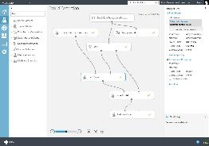
Making advanced analytics accessible to Hadoop Microsoft Azure Machine Learning
ML Studio
ML API service
Easily make changes
HDInsight
SQL Server VM
Cloud
Workspace
SQL DB
Blobs & tables
Microsoft Azure Portal
Publish API
Publish API in minutes
Desktop
Devices
Applications
Dashboards
Web
Historical data
Test model types
Run & refine
Results

Slide 25
Lab 0: Provisioning an HD Insight Cluster

Slide 26
Introducing and development with Hive

Slide 27
Apache HIVE: What is it?
A data warehouse built using Hadoop for querying and analyzing big data
Enables you to view big data as tables and use familiar SQL-like operations on them
Table-like view on big data
Not a substitute for full-fledged RDBMS
Query Hive tables using HiveQL, a SQL-like query language
HiveQL queries are eventually executed as MapReduce or Tez programs by Hadoop
Hive
HiveQL
Table view
HDFS

Slide 28



Hive architecture
Built on top of Hadoop to provide data manage-ment, querying, and analysis
Access and query data through simple SQL-like statements, called Hive queries
In short, Hive complies and Hadoop executes
Hive
ODBC
JDBC
Hive web interface (HWI)
Command line interface (CLI)
Metastore
Thrift server
Compiler, optimizer, executor
Hadoop
Head node
Name node
Data nodes/task nodes

Slide 29
HiveQL: Execution flow
ODBC
JDBC
Hive web interface (HWI)
Command line interface (CLI)
Hive clients send HiveQL queries to the driver
The driver sends query to the compiler for parsing and syntax checking
The compiler gets the metadata from the store and returns execution plan to the driver
The driver sends execution plan to the execution engine
The execution engine submits the plan as a MR job to be executed by Hadoop; after Hadoop completes execution, the execution engine gets results that are returned to the driver, which then returns the results to Hive clients
Execution engine can execute metadata operations against Metastore
1
Thrift server
2
1
3
2
Driver
4
Compiler
4
Metastore
3
5
Execution
5.1
5
5.1
Hadoop / HDFS

Slide 30
Hive data organization hierarchy
Database
Table
Table
Table
Partition
Partition
Partition
Partition
Partition
Partition
Buckets/clusters
Buckets/clusters
Buckets/clusters
Buckets/clusters
Buckets/clusters
Buckets/clusters

Slide 31
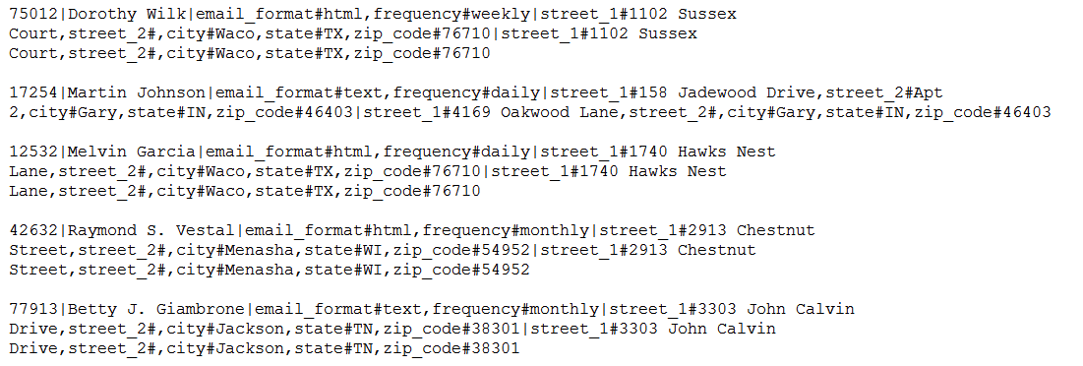
Sample data – customer file
Customer ID
Customer name
Email preferences
Shipping address
Billing address

Slide 32
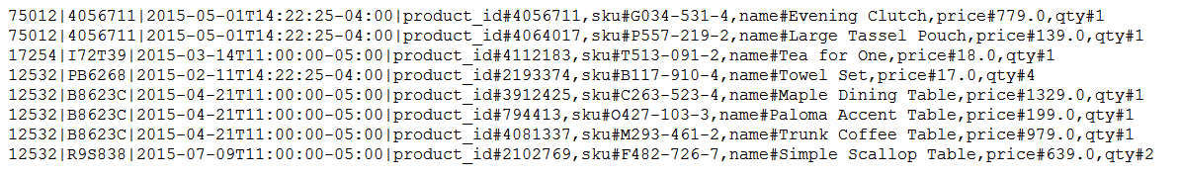
Sample data – orders file
Customer ID
Order date and time
Order ID
Product details

Slide 33


Create, load, and query Hive tables
HiveQL includes data definition language, data import/export, and data manipulation language statements
See https://cwiki.apache.org/confluence/display/Hive/LanguageManual
Create table
Import data into Hive table
Query data using SQL-like statement

Slide 34
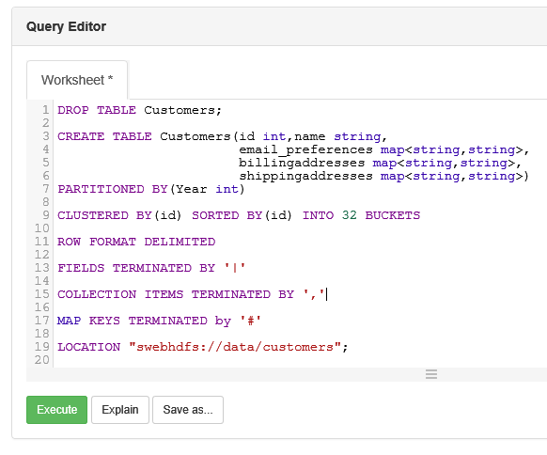
Hive table creation
Hive supports complex types such as “map”
Internal tables | Manage/control the data. If an internal table is dropped, the associated data is deleted. Default.
External tables | Do not manage/control the data. If an external table is dropped, the associated data is not deleted.
LOCATION | Location of the data can be specified with LOCATION keyword: Location can be a HDFS folder that already has the data. Or data can be added later to an empty folder If not specified, default is: /hive/warehouse/
Multiple views | Multiple tables can point to same data
HDInsight Hive Tables can directly point to Azure Data Lake Store files
* Order table creation is shown in notes sections

Slide 35
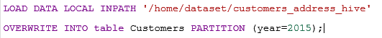

Loading data into Hive Tables
Options
Load local data | LOAD DATA LOCAL INPATH ... INTO TABLE … hadoop dfs –put ‘local source’ ‘destination’
 | INSERT INTO TABLE ‘destination-hive-table’ SELECT ‘select-statement’ FROM ‘source-hive-table’
Insert values directly | INSERT INTO TABLE ‘tablename’ VALUES (row1_values), (row2_values), ….
Local file
/hive/warehouse/customer
‘/home/dataset/customers_address_hive’
Hadoop/HDFS
* Loading data into orders table is shown in notes sections

Slide 36
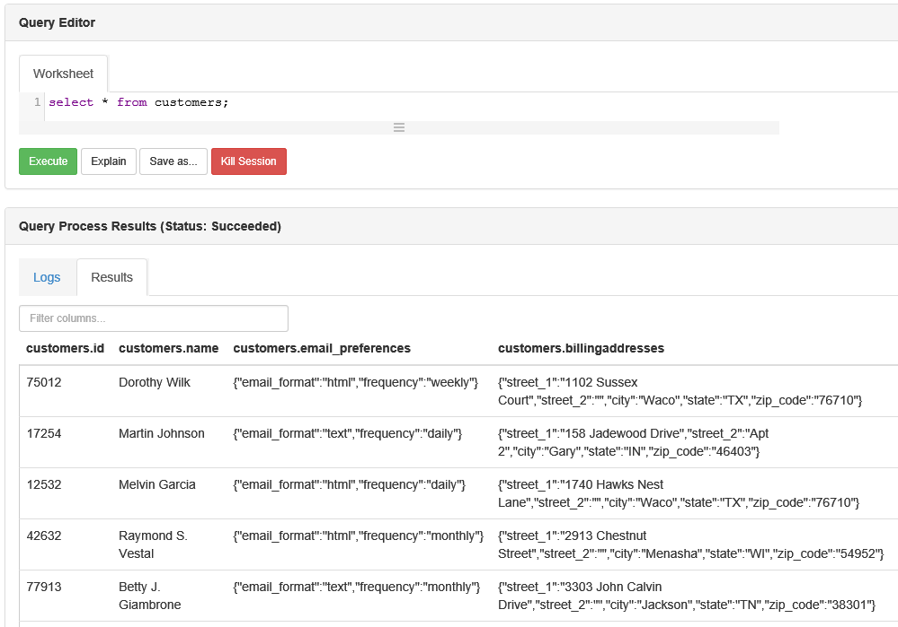
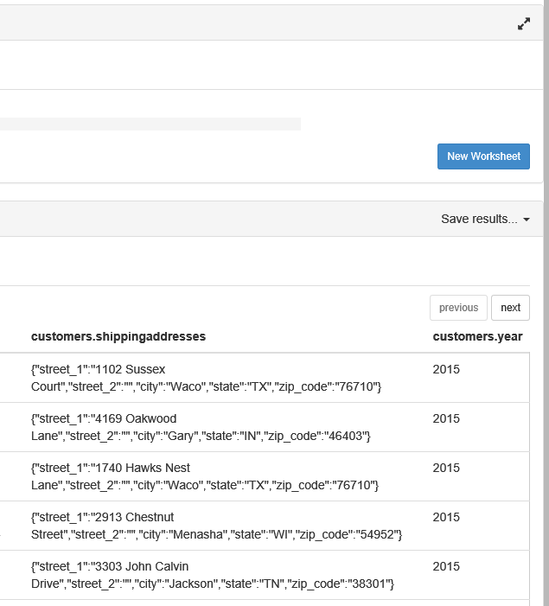
Customer table

Slide 37
HiveQL overview
SQL-like syntax: SELECT … FROM … WHERE
ALL and DISTINCT
Support for Partitioning
GROUP BY
SORT BY, ORDER BY, CLUSTER BY, DISTRIBUTE BY
JOINs: LEFT, RIGHT, FULL, OUTER, LEFT SEMI, CROSS JOIN
Built-in: Operators, Functions, Aggregate Functions
User defined functions (UDFs)
Support for Subqueries
Windowing and analytics functions
HiveQL

Slide 38
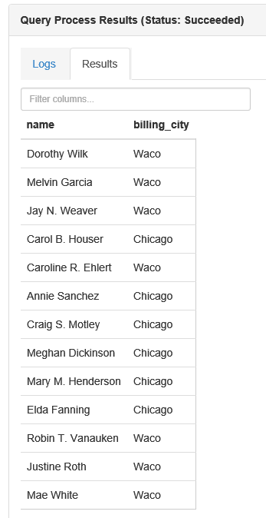
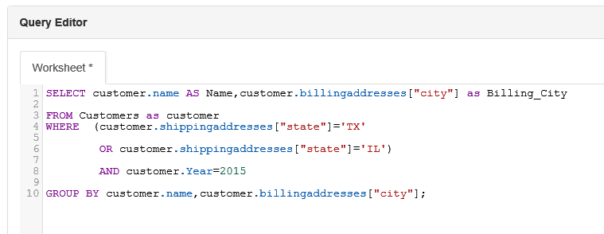
HiveQL
Query: Find name and billing city of customers with shipping addresses in ‘TX’ or ‘IL‘. Group by City.

Slide 39
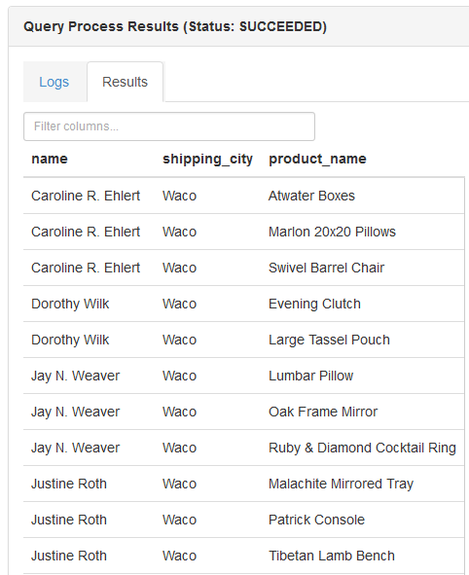
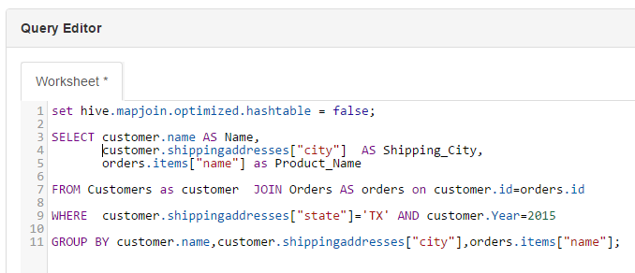
HiveQL
Query: Find names of products purchased by customers whose shipping address is in Texas.

Slide 40
Comparing RDBMS and Hive
 | RDBMS DW | Hive
Structure | Schema on write | Schema on read
Access | SQL | HiveQL
Indexes | Yes | Yes
Updates | Yes | No
Locking | Yes | Table and partition
Referential Integrity | Yes | No
Query optimization | Yes | No
Access pattern | Read and write many times | Write once, read many times
OLTP applications | Yes | No

Slide 41
Lab 1: Hive on Tez

Slide 42
Introducing and development with Pig

Slide 43
Apache Pig: What is it?
A scripting platform based on MR or Tez for analyzing large data sets stored in HDFS
Makes big data analytics accessible to non-programmers who may find writing MR programs an obstacle
Characteristics:
Extensible: User can create custom functions
Easy to program: Complex tasks involving interrelated data transformations can be simplified and encoded as dataflow sequences
Self-optimizing: automatically optimizes execution of Pig jobs
Use cases:
ETL
Iterative data processing
Research on raw data
Script
SQL
Java
Engines
Others
Others
Pig
Hive
Cascading
HBase
Accumulo
Storm, Solr
Spark
Engines
ISV
engines
Tez
Tez
Tez
Tez
YARN: Data Operation System
(Cluster Resource Management)
HDFS
(Hadoop Distributed File System)

Slide 44

Apache Pig: Components
Pig Latin
Command-based language
Designed specifically for data transformation and flow expression
Execution environment
The engine in which Pig Latin commands are executed
Supports local and Hadoop modes
Pig compiler
Converts Pig Latin to optimized MR or Tez program
Pig Grunt
Pig Server
Pig Latin
Compiler
Execution engine
Tez
MR
Yarn
HDFS

Slide 45
Apache Pig Latin: Types
int | Signed 32-bit integer
long | Signed 64-bit-integer
float | 32-bit floating point
double | 64-bit floating point
chararray | Character array(string) in Unicode
bytearray | Byte array (blob)
boolean | boolean
tuple | An ordered set of field. e.g: (2,4)
bag | A collection of tuples. e.g: {(2,4), (3, 9)}
map | A set of key value pairs. e.g: [age#32]
Pig types

Slide 46
Apache Pig: Commands
Load | Read data from the file system
Store | Write data to the file system
Dump | Write output to stdout
Foreach | Apply expressions to each record and generate one or more record
Filter | Apply predicates to each record and remove record where false
Group Cogroup | Collect records with the same key from one or more inputs
Join | Join two or more inputs based on a key
Order | Sort records based on a key
Distinct | Remove duplicate records
Union | Merge two datasets
Limit | Limit the number of records
Split | Split data into 2 or more sets, based on filter conditions
Pig commands

Slide 47
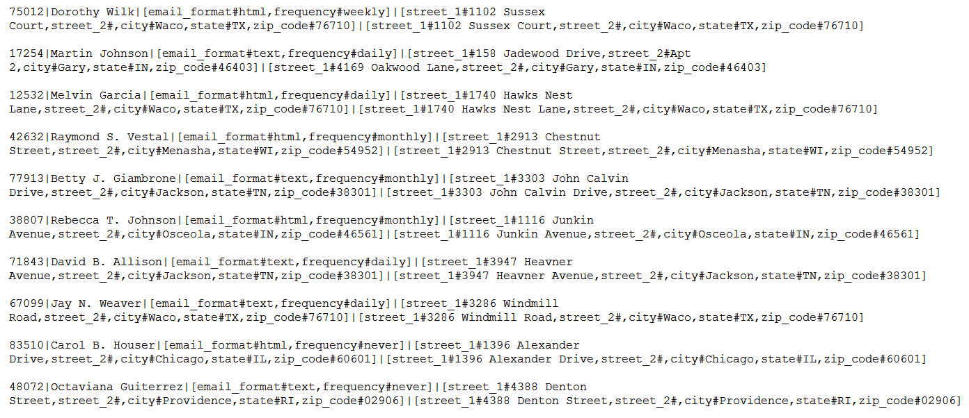
Pig – Sample ‘Customers’ data file

Slide 48
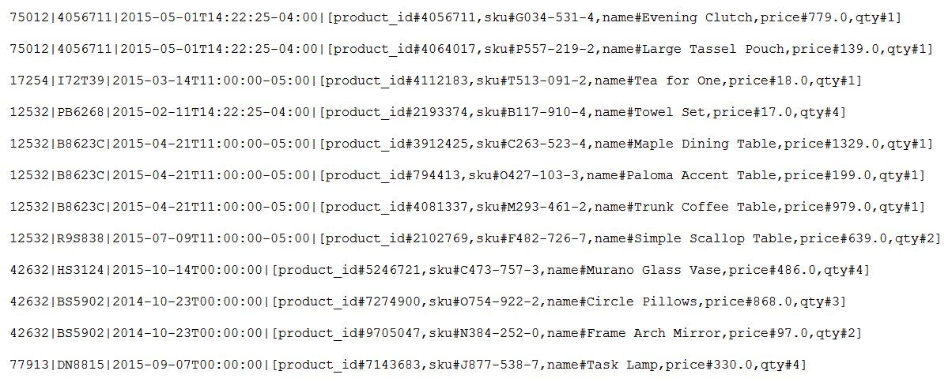
Pig – Sample ‘Orders’ data file

Slide 49
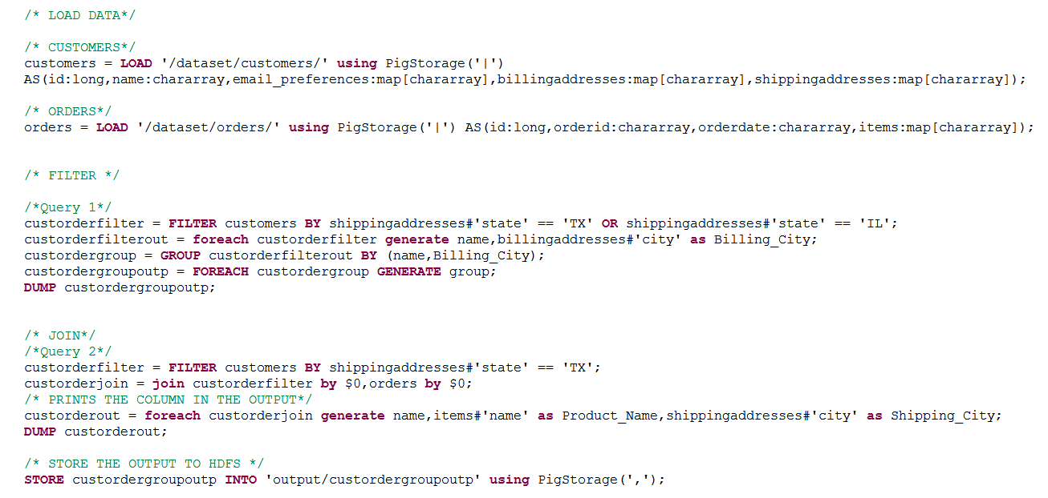
Loading and querying with Pig

Slide 50
Lab 2: Running the Pig application

Slide 51
Introducing and development with HBase:

Slide 52

Apache HBase: What is it?
A distributed, columnar, NoSQL database based on Hadoop
Large scale
Linear scalability with automatic partitioning
Billions of rows, X millions of columns
Many deployments with 1,000+ nodes, PBs of data
Low latency
Supports real-time random read and writes
Strongly consistent read and writes
Supports transactions (not fully ACID)
Reliable and fault tolerant
Automatic failover in case of server failures
Open source
Modelled after Google’s BigTable

Slide 53
HBase: Data model
Tables are logical collections of rows stored in multiple regions
A row is identified by a rowkey, which is unique in a table
Column families – Data in a row are grouped together as column families (each column family has one or more columns)
Columns – A column is identified by a column qualifier that consists of the column family name concatenated with the column name using a colon – example: columnfamily:columnname. Rows within a table can have varied number of columns or missing columns (sparse tables)
Cell – A cell stores data and is essentially a unique combination of rowkey, column family, and column
Table with customer and sales column families
Row key | Customer |  | Sales
Customer ID | Name | City | Product | Amount
101 | John White | Los Angeles, CA | Chairs | $400.00
102 | Jane Brown | Atlanta, GA | Lamps | $200.00
103 | Bill Green | Pittsburgh, PA | Desk | $500.00
104 | Jack Black | St. Louis, MO | Bed | $1600.00
Column Families
Customer column family is made up of two columns – Name and city
Sales column family is made up of two columns – Product and amount

Slide 54
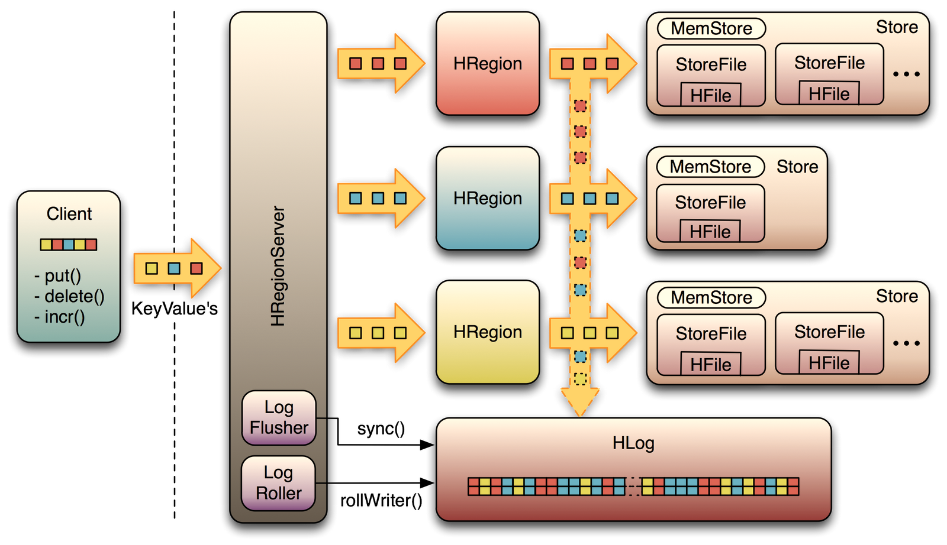
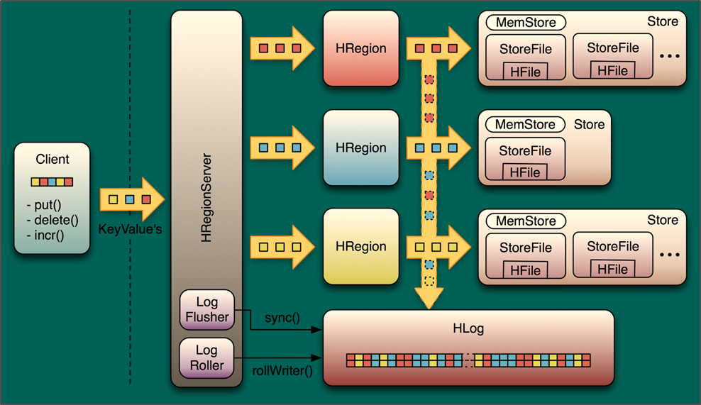
HBase: Key components
Clients
HMaster
Zookeeper
HRegionServer
HRegion
HLog
MemStore
StoreFile
MemStore
Store
HRegion
StoreFile
StoreFile
HFile
HFile
MemStore
Store
Client
put()
delete()
incr()
HRegion
StoreFile
HFile
HRegionServer
KeyValues
MemStore
Store
HRegion
StoreFile
StoreFile
HFile
HFile
Log
flusher
sync()
HLog
Log
roller
rollWriter()
HFiles and HLogs are stored in HDFS

Slide 55
HBase key components: Overview
HMaster
Responsible for admin operations
Manages and monitors cluster
Assigns regions to region servers
Controls load balancing and failover
HRegionServer
Hosts and manages regions
Splits regions automatically
Handles read/write requests
Communicates with clients directly
HRegions
Consists of MemStore and one store per ColumnFamily
Each store may have multiple StoreFiles
HBase
A write-ahead Log, one per HRegionServer. All changes are recorded in this log. Implemented as a Hadoop sequence file that stores records as sets of key/value pairs
HLog
StoreFile
The data lives in StoreFiles, with multiple StoreFiles per store
StoreFiles are implemented as HFiles (permit random read-write access)
Memstore
An in-memory cache, one per store. All changes are first stored in the cache and then written persistently to the StoreFile asynchronously.

Slide 56
HBase: Object hierarchy
Table
HBase table
Region
Regions for the table. HBase scales by having regions across many servers.
Store
Store per ColumnFamily for each region
MemStore
MemStore for each store for each region per table
StoreFile
StoreFiles for each store for each region for table
Block
Blocks within StoreFile within store for each region for the table

Slide 57
Concept: Regions, rows, and partitioning
Rows are distributed/partitioned among multiple regions
Each region holds range of keys
At first there is only one range; when full, HRegionServer splits range and redistributes rows
Servers can have 10–1,000 regions with 1–2 GB per region
Benefits of splitting data into regions:
Fast recovery when region fails
Load balancing when server is overloaded as regions may be moved between servers
Splitting is done asynchronously while data is being read
Splitting is automated, without manual intervention
Table A
Region Server 7
a
b
c
d
e
f
g
h
j
k
l
m
n
o
p
Table A, Region 1
Table A, Region 2
Table G, Region 1070
Table L, Region 25
Region 1
Region 2
Region Server 86
Table A, Region 3
Table C, Region 30
Table F, Region 160
Table F, Region 776
Region 3
Region Server 367
Table A, Region 4
Table C, Region 17
Table E, Region 52
Table P, Region 1116
Region 4
Rows of Table A are horizontally split into 4 regions
Region 1 spans, RowKeys ‘a’ thru ‘d’
Regions are hosted on different region servers
Region Server 86 hosts Region 3 of Table A, Region 30 of Table C, etc.
Placement of regions may change as servers are added/removed, servers fail, data is added/removed, etc.

Slide 58

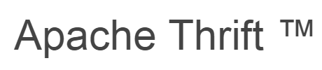
HBase access API: Insert, read, delete data
Operation | API/command
Insert or update data | You can insert/add new data or update existing cells using ‘put’ or ‘add’ command
Read data | To read data, use: ‘Get’ command to get a single row of data; you can get entire row or only specified columns ‘Scan’ command to fetch entire table or only rows matching specified ‘RowKeys’
Delete data | To delete data, use: ‘Delete’ command to delete specific cell ‘Deleteall’ to ‘delete’ all row cells
HBase rest interface
Web application
Cluster Boundary
Thrift/REST gateway
HBase client

Slide 59
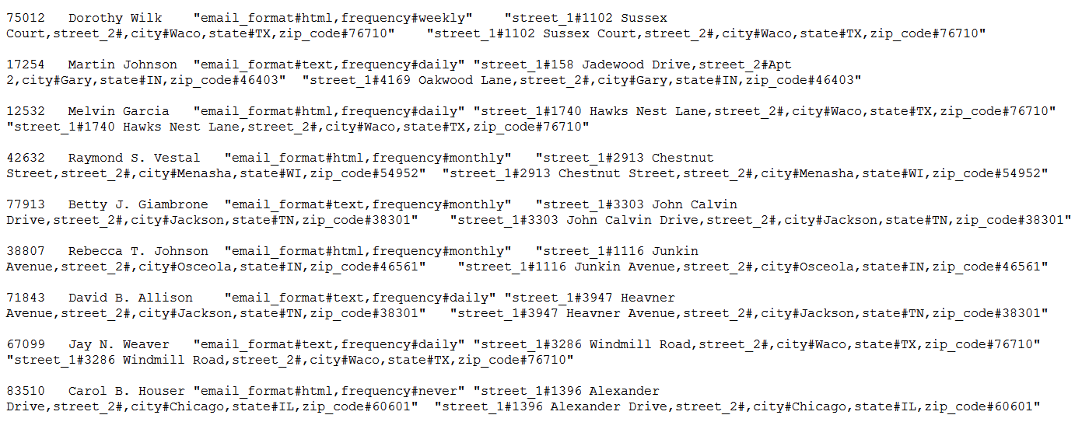
HBase – Sample ‘Customer’ data file
This is a tab separated file
customers_address_hbase.txt

Slide 60
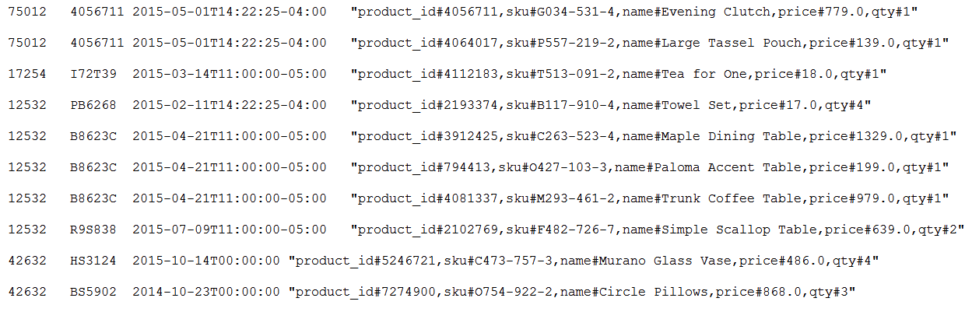
HBase – Sample ‘Orders’ data file
customers_orders_hbase.txt

Slide 61
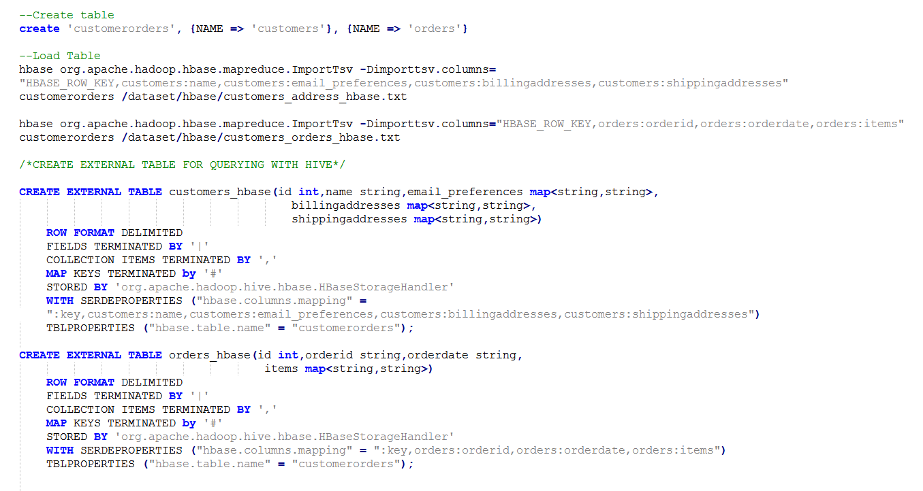
Create, load, query HBase tables
HBase supports Hive queries. Hive queries from previous slides can be run directly on these HBase tables.

Slide 62
HBase as a platform
Running on top of HBase using it as a datastore
Phoenix
Kiji
Titan
Phoenix
Titan
Continuity
OpenTSDB
Continuity
Splice machine
Kiji
OpenTSDB
Splice machine
Integrated with HBase
Hive
Solr
Storm
Impala
Spark
HBase
Drill
Pig
Flume
Ganglia
Hive
Solr
Storm
Impala
Spark
Drill
Pig
Flume
Ganglia

Slide 63
When to use HBase in Azure
Existing expertise or workload on HBase
Storing large amounts of data
Need high write throughput
Need efficient random access within large data set
Need to scale gracefully with data
For structured and semi-structured data
Don’t need full RDBMS capabilities (cross-table transactions, joins)

Slide 64
HBase and RDBMS
 | RDBMS | HBase
Data layout | Row oriented | Column oriented
Transactions | ACID over multiple rows and tables | ACID over single row or adjacent row groups only
Query language | SQL | None (APIs: get, put, scan, … )
Joins | Yes | No
Indexes | On any column or multiple columns | Single row index only
Data size | Usually limited to terabytes | Petabytes

Slide 65
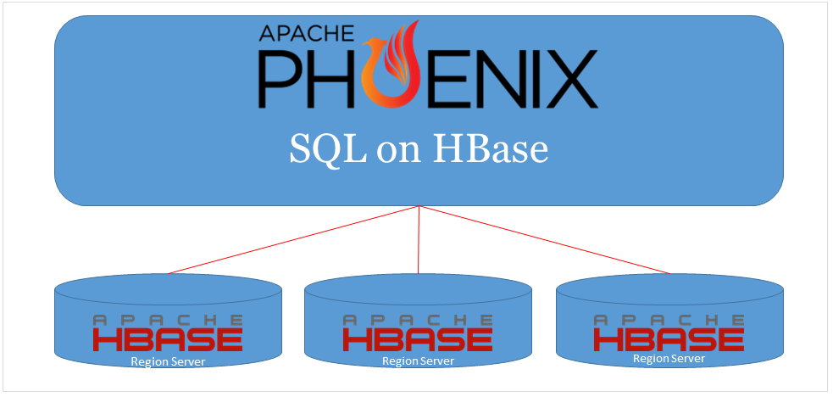
Apache Phoenix – SQL over HBase
Apache Phoenix is a relational database layer on top of HBase
Lets you view HBase table as regular relational tables (rows and columns), and maps HBase data model to relational data model
Lets you query HBase tables using SQL
Creates scale-out relational database using HBase
Integrates with Hadoop ecosystem (Pig, Scoop, Flume)
Requires no additional servers

Slide 66
Apache Phoenix: SQL support
SQL language construct | Supported? (yes/no)
CREATE/DROP/ALTER TABLE | Yes
UPSERT / DELETE | Yes
SELECT | Yes
WHERE / HAVING | Yes
GROUP BY / ORDER BY | Yes
LIMIT | Yes
JOIN | Yes (with limitations)
VIEWS | Yes
Transactions | No

Slide 67
Lab 3: HBase and Phoenix

Slide 68

Summary
Understand big data and Hadoop
Overview of Hadoop ecosystem
HDInsight and Hadoop ecosystem
Understanding Hive, Pig, HBase, and Apache Storm―and their implementation in HDInsight

